Slide 1
Flights Revenue and Load Factor Analysis
Giulio Fabbri
Notes:
As you know the task topic is free choice so I decided to analyse the flight performance (on both Revenues and LF) seeing if we could have improved the fares strategy.
We have four Ryanair flights (code FR AIATA),
leaving Dublin for 4 unknown destinations at 4 different times on 5th May 2022 (the public holiday at the beginning of May was the 2nd, so it was a regular day, Thursday).
The most important measures we have for these flights are Total revenues (revenues from fees and secondary revenues), Load Factors (Bookings over capacity) and Fares , starting from 90 days before departure up to the departure date.
The competition consists of four corresponding Aer Lingus flights for which we have the fares.

Slide 2
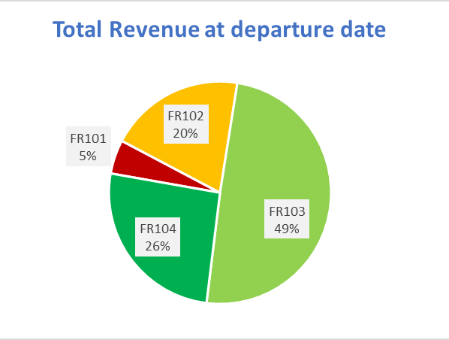
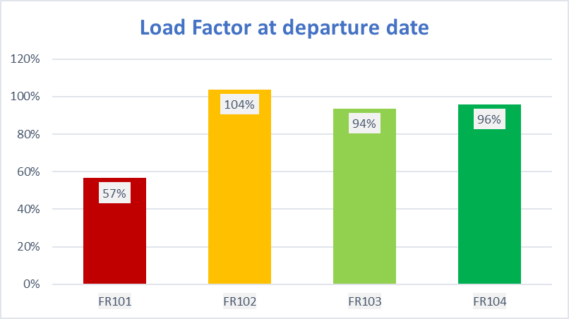
Flights performance at departure date
Notes:
What happens at departure date?
Flight FR101 contributes the least on revenue (5%) and it also has the lowest LF -> Hypothesis that the prices were set too high
Flight FR102 ranks third in revenue generation at 20%, yet it boasts the highest load factor at 104%, surpassing full capacity.-> Hypothesis that we should increase prices both for increasing revenues and lowering demand
Flight FR103 generates the highest revenue, accounting for almost 50%, while ranking third in load factor.-> A 94% load factor is strong (according to Statista website for Ryanair load factor analysis), and this flight is notable for starting with a very high load factor (60%) already 90 days before departure. Therefore, we need to exercise caution with predicting price adjustments.
https://www.statista.com/statistics/1126148/ryanair-passenger-load-factor/#:~:text=In%20the%20financial%20year%20ending,million%20passengers%20on%20its%20flights.
Flight FR104 ranks second in both load factor and revenue. We should analyse whether a price increase is feasible, considering the revenue comparison with FR103

Slide 3
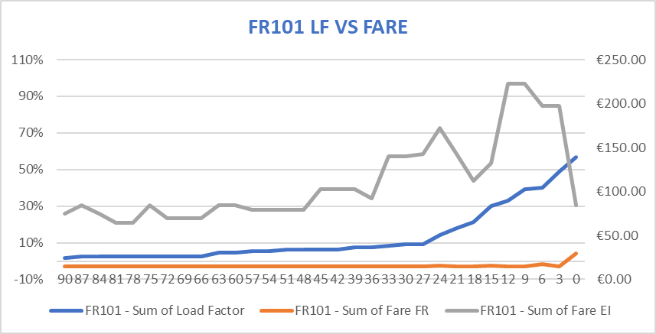
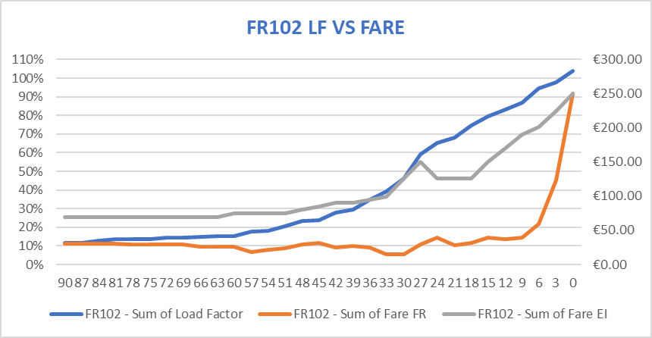
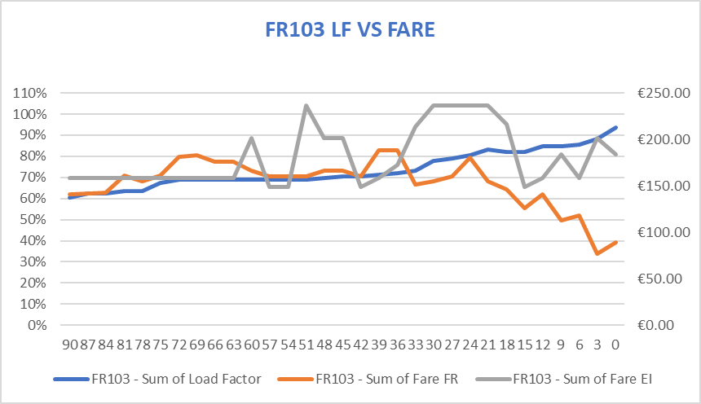
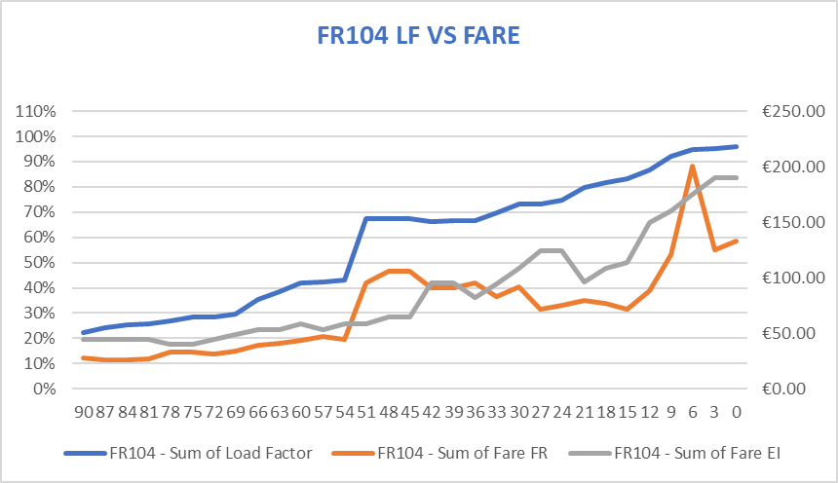
Overview of Pricing Strategies Adopted
Notes:
Competition fares (grey) that can be compared to Ryanair fares to see if there was margin to increase prices.
Load factor (left axis) and Fares (right axis) over days until departure.

Slide 4
Possible Improvement strategy
When could we have raised fares?
If customers are indifferent to fares changes (Elasticity of the prices around 0 or positive)
If we have margin with respect to competition fares
If we have strong seasonality (ex.Sunday)
What we estimated from the data:
Fares-Daily booking demand Elasticity
The Fares’ effect on number of daily bookings
The Fares’ effect on daily Revenues:
If we can increase fares without reducing bookings we still have to check if this reduces revenues
(higher fares could reduce secondary revenues like additional baggage purchases)
$$Daily Bookings Number=βFare+βDUD+βWeekday$$
$$Daily Revenues=βFare+βDUD+βWeekday$$
Notes:
References:
Competition margin: slide 7 (in grey the competition fares)
Fares’ Elasticity: backup slide 8
The Fares’ change effect on number of daily bookings: backup slide 9
The Fares’ effect on daily Revenues; backup slide 10

Slide 5
Conclusions
FR101:
LF too low
Elasticity strong variation, no seasonality
High margins with competition
FR102:
LF too high
Scarse Elasticity
Significant week seasonality
High margins with competition
in the middle of the period
FR103
Good LF performance
Scarce elasticity
Margins with competition fares at the end
FR104
Good LF performance
Scarce eleasticity
Scarce margin with competition
LF is very low and lowering fares should not lead to an increase in bookings
Increasing fares could increase revenues without lowering LF but this flight has an high risk to create a financial loss.
Fares should have been increased during the middle period, taking into account the weekdays with higher demand.
This adjustment would have helped manage the hogh demand level, but scarce elasticity must be kept in mind
We should study whether the LF at 60% already at the beginning is recurring, if so prices could be increased especially at the end.
Efficiency is good, but the final drop in fares could have been avoided. Only one additional booking was gained from a 60% fare reduction, before fares were subsequently increased again.

Slide 6
Metadata
Days Until Departure
Departure Date
Route: 4 routes, 4 flights
Departure Time: 4 different times
Flight Number: FR -> Ryanair flight
Capacity: always 189
Total Booked
Total Revenue: comprehensive of ancillary revenues
Load Factor: computed as Total Booked / Capacity
Fare FR
Competition
Fare EI: fare competition (Aer Lingus)

Slide 7
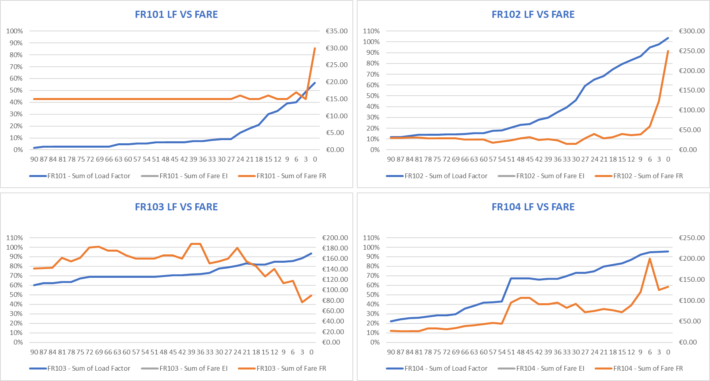
Overview of Pricing Strategies Adopted
Notes:
We can see the strategies adopted to establish the fares from the graph of Load factor (left axis) and Fares (right axis) over days until departure
FR101: The fares model could be too sensitive to Load Factor, starting to increase fares as soon as there is a Lf increase (27 dbd) even if we are only at 10% of LF, not adjusting prices immediately could have avoided this cycles leading to higher LF
FR102: The fare model is too indifferent to LF, taking the opposite approach. Fares are lowered to boost LF, leading to a sharp increase only in the week before departure. In the middle section we could have higher fares.
FR103: Best flight with the highest revenues, but it started already at 60% LF We might have achieved better results by keeping prices higher.
FR104: Fares adjustments seem correct; the spike creates a plateau. However, the drop in the last week, as we’ll see, could have been avoided.

Slide 8
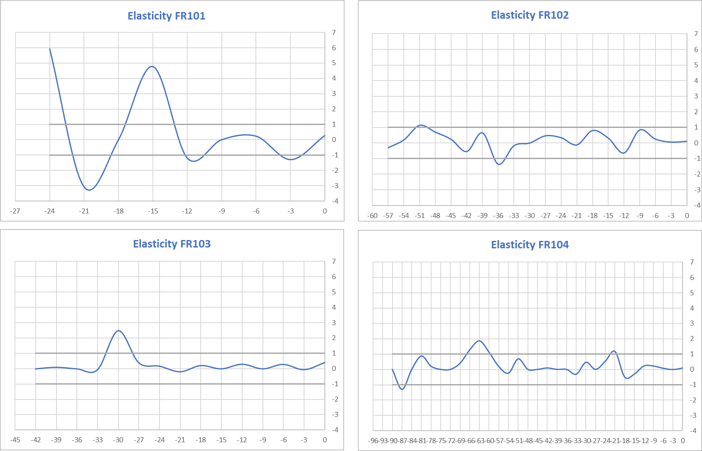
Notes:
Price elasticity of fares in relation to the number of bookings.
Fr102 Fr103 fr104 shows low elasticity

Slide 9
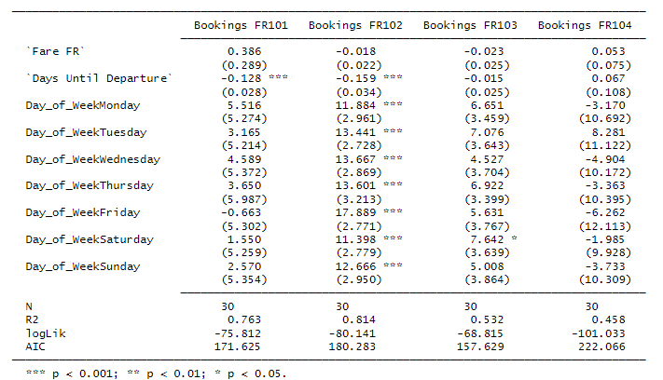
Daily bookings vs Fares
Notes:
No significant effect of fares on number of bookings (confirmation of low elasticity)
FR102 shows significant seasonality

Slide 10
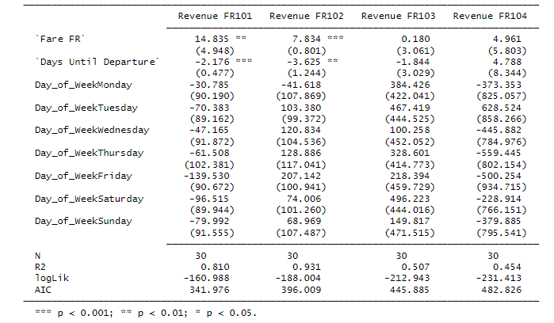
Daily Revenues vs fares
Notes:
Positive effect of fares on revenues, no inverse relationship

